Slide 1
Chapter 9: Medians and Order Statistics

Slide 2
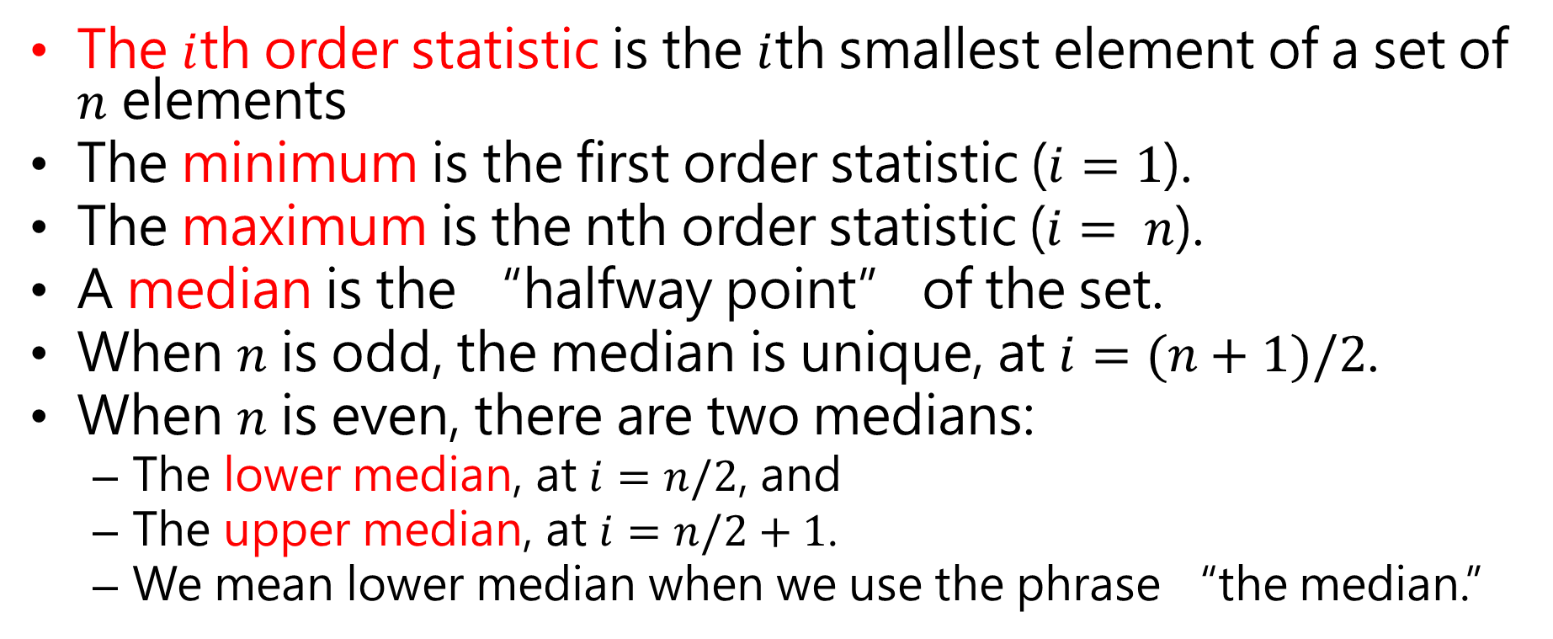
Chapter 9 overview
The $i$th order statistic is the $i$th smallest element of a set of $n$ elements
The minimum is the first order statistic ($i=1$).
The maximum is the nth order statistic ($i= n$).
A median is the “halfway point” of the set.
When $n$ is odd, the median is unique, at $i=(n+1)/2$.
When $n$ is even, there are two medians:
The lower median, at $i=n/2$, and
The upper median, at $i=n/2+1$.
We mean lower median when we use the phrase “the median.”

Slide 3
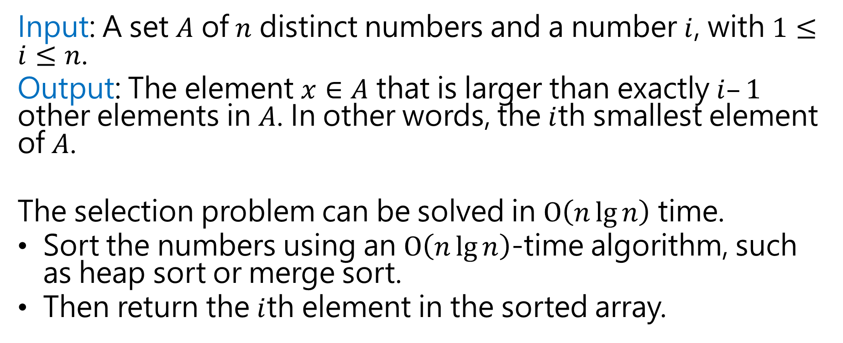
The selection problem
Input: A set $A$ of $n$ distinct numbers and a number $i$, with $1≤i≤n$.
Output: The element $x∈A$ that is larger than exactly $i–1$ other elements in $A$. In other words, the $i$th smallest element of $A$.
The selection problem can be solved in $O\left(n\lg{n}\right)$ time.
Sort the numbers using an $O\left(n\lg{n}\right)$-time algorithm, such as heap sort or merge sort.
Then return the $i$th element in the sorted array.

Slide 4
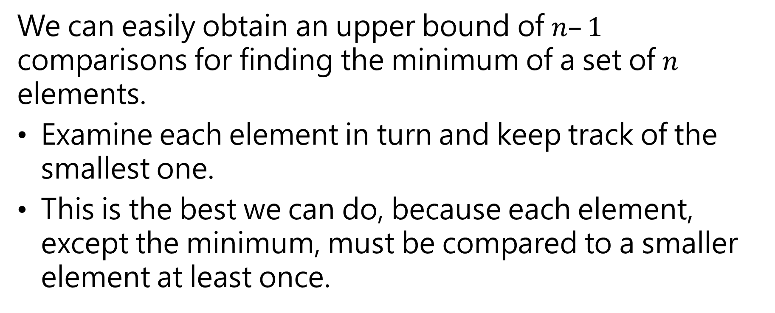
Minimum and Maximum
We can easily obtain an upper bound of $n–1$ comparisons for finding the minimum of a set of $n$ elements.
Examine each element in turn and keep track of the smallest one.
This is the best we can do, because each element, except the minimum, must be compared to a smaller element at least once.

Slide 5

Minimum and Maximum
The following pseudocode finds the minimum element in array $A\left[1…n\right]$:

Slide 6

Minimum and Maximum
The maximum can be found in exactly the same way by replacing the $>$ with $<$ in the above algorithm.

Slide 7
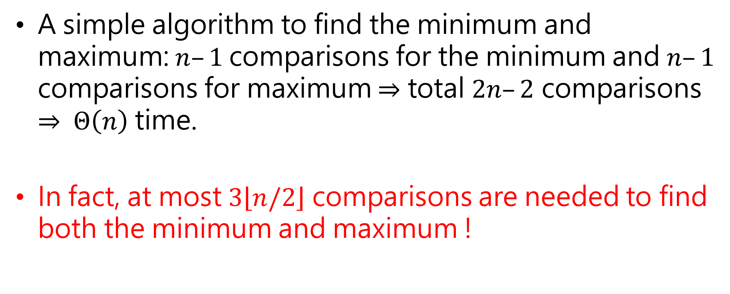
Simultaneous minimum and maximum
A simple algorithm to find the minimum and maximum: $n–1$comparisons for the minimum and $n–1$ comparisons for maximum $⇒$ total $2n–2$ comparisons $⇒$ $Θ\left(n\right)$ time.
In fact, at most $3\left\lfloor n/2\right\rfloor$ comparisons are needed to find both the minimum and maximum !

Slide 8


















3, 6, 9, 5, 10, 12, 1, 14, 16, 8
comparison
comparison
comparison
comparison
comparison
$min=3$ vs 5
$max$=6 vs 9
$min=3$ vs 10
$max=9$ vs 12
$min=3$ vs 1
$max=12$ vs 14
$$min=3$$
$$max=6$$
$min=1$ vs 8
$max=14$ vs 16
$$min=3$$
$$max=9$$
$$min=3$$
$$max=12$$
$$min=1$$
$$max=14$$
$$min=1$$
$$max=16$$

Slide 9




3, 6, 9, 5, 10, 12, 1, 14, 16, 8, 17
comparison
$$min=3$$
$$max=6$$
$min=1$ vs 17
$max=16$ vs 17
$$min=1$$
$$max=17$$

Slide 10
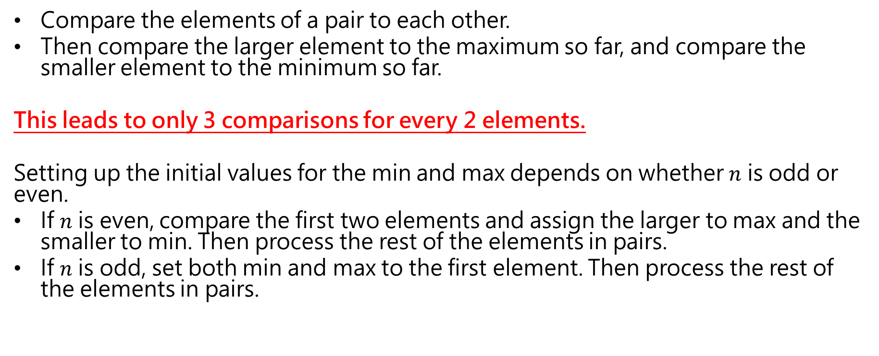
Simultaneous minimum and maximum (cont.)
Compare the elements of a pair to each other.
Then compare the larger element to the maximum so far, and compare the smaller element to the minimum so far.
This leads to only 3 comparisons for every 2 elements.
Setting up the initial values for the min and max depends on whether $n$ is odd or even.
If $n$ is even, compare the first two elements and assign the larger to max and the smaller to min. Then process the rest of the elements in pairs.
If $n$ is odd, set both min and max to the first element. Then process the rest of the elements in pairs.

Slide 11
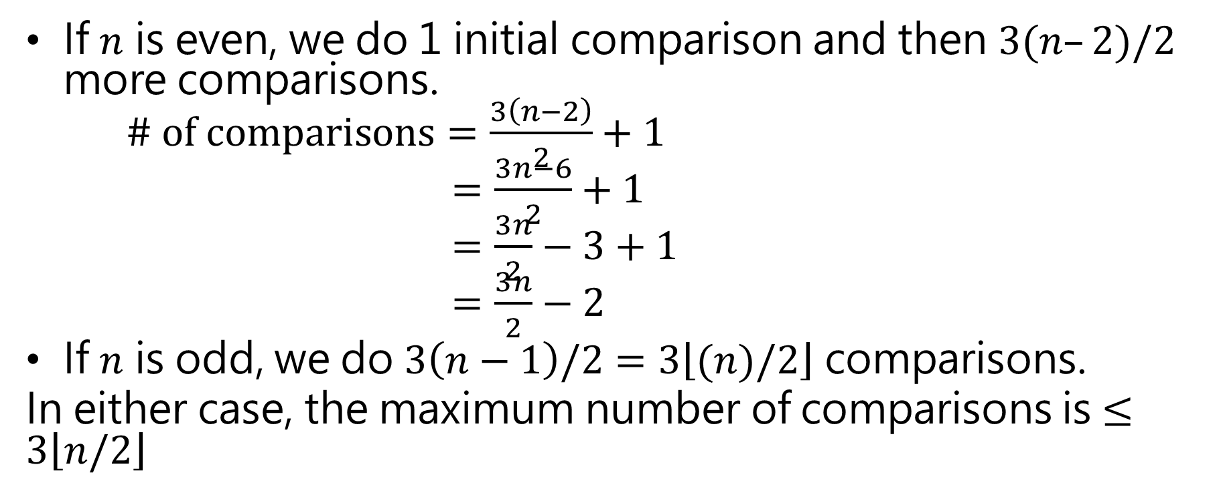
Analysis of the total number of comparisons
If $n$ is even, we do 1 initial comparison and then $3(n–2)/2$ more comparisons. $\# of comparisons=\frac{3\left(n−2\right)}{2}+1$ $=\frac{3n−6}{2}+1$ $=\frac{3n}{2}−3+1$ $=\frac{3n}{2}−2$
If $n$ is odd, we do $3\left(n−1\right)/2=3\left\lfloor (n)/2\right\rfloor$ comparisons.
In either case, the maximum number of comparisons is $≤3\left\lfloor n/2\right\rfloor$

Slide 12










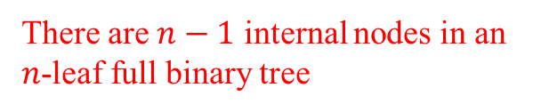
The second smallest of $n$ elements can be found with $n+\left\lceil \lg{n}\right\rceil −2$ comparisons in the worst.
There are $n−1$ internal nodes in an $n$-leaf full binary tree
$$≤$$
Height is $\left\lceil \lg{n}\right\rceil$
$$≤$$
$$≤$$
$n−1+\left\lceil \lg{n}\right\rceil −1=n+\left\lceil \lg{n}\right\rceil$-2
…
…
$$≤$$
$$≤$$
$$≤$$
…
Min value
$$n$$

Slide 13
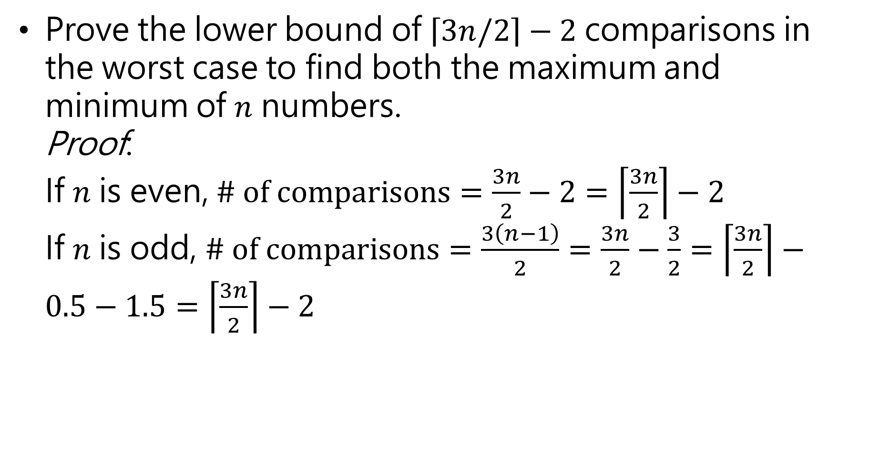
Prove the lower bound of $\left\lceil 3n/2\right\rceil −2$ comparisons in the worst case to find both the maximum and minimum of $n$ numbers. Proof: If $n$ is even, $\# of comparisons=\frac{3n}{2}−2=\left\lceil \frac{3n}{2}\right\rceil −2$ If $n$ is odd, $\# of comparisons=\frac{3\left(n−1\right)}{2}=\frac{3n}{2}−\frac{3}{2}=\left\lceil \frac{3n}{2}\right\rceil −0.5−1.5=\left\lceil \frac{3n}{2}\right\rceil −2$

Slide 14
Selection in expected linear time

Slide 16
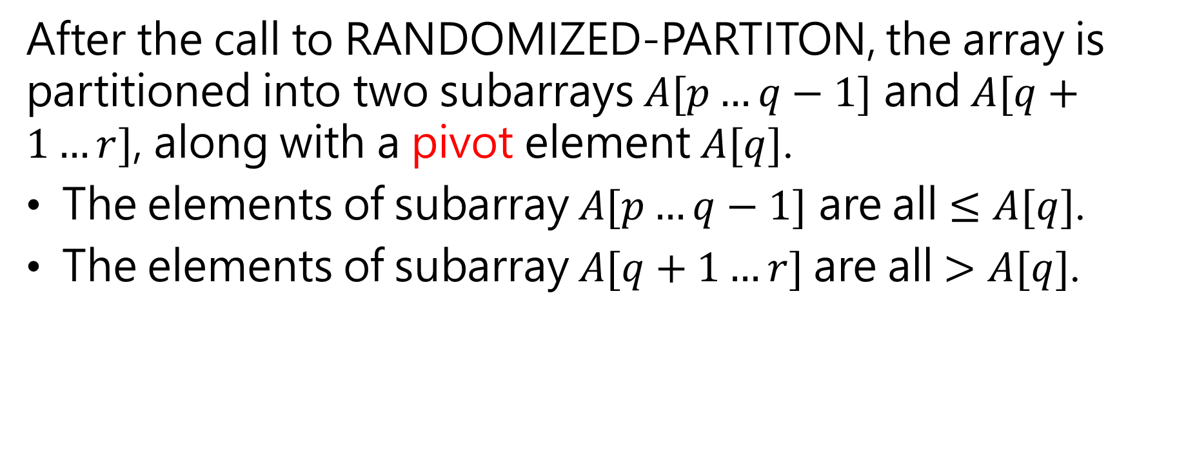
Selection in expected linear time
After the call to RANDOMIZED-PARTITON, the array is partitioned into two subarrays $A[p…q−1]$ and $A[q+1…r]$, along with a pivot element $A[q]$.
The elements of subarray $A[p…q−1]$ are all $≤A[q]$.
The elements of subarray $A[q+1…r]$are all $>A[q]$.

Slide 17
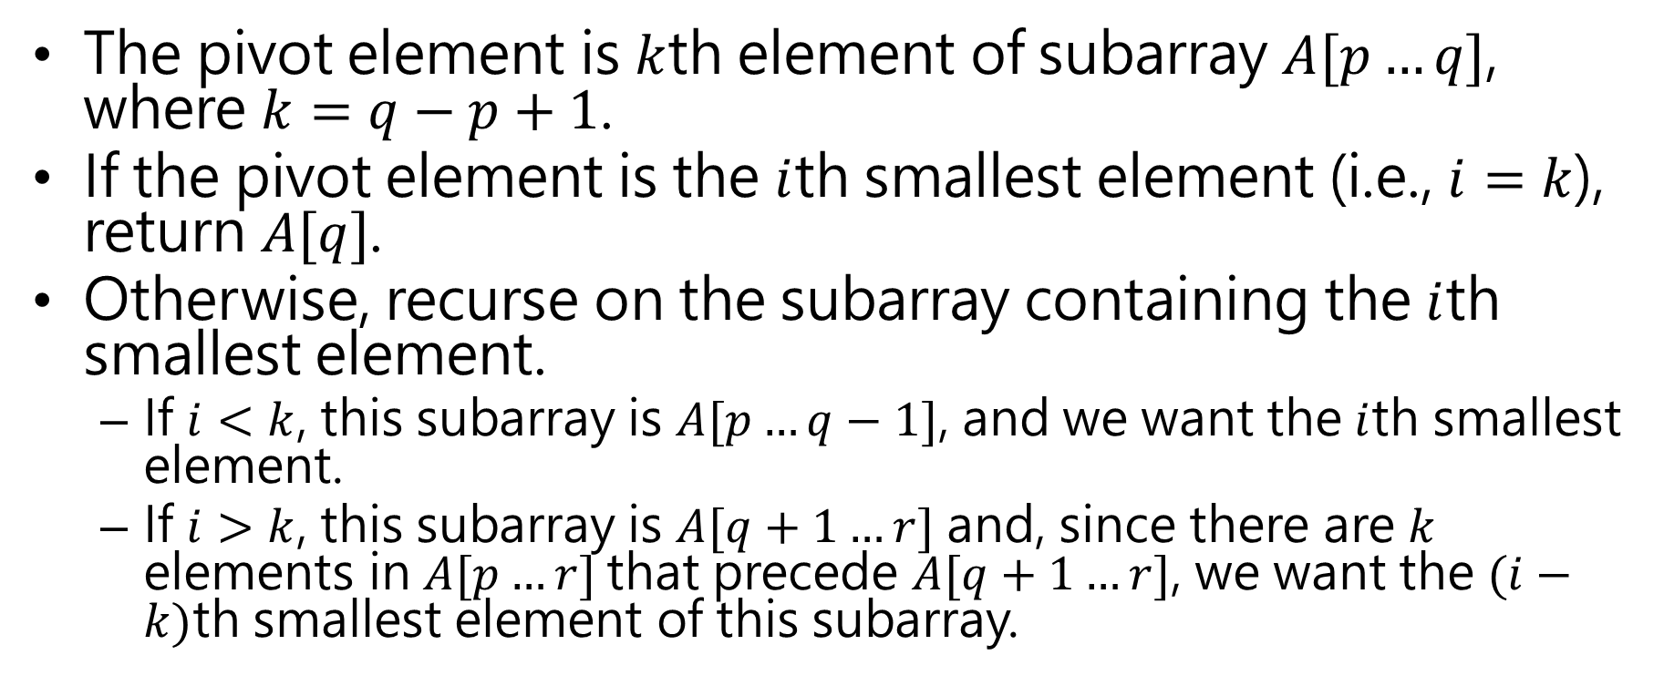
Selection in expected linear time
The pivot element is $k$th element of subarray $A[p…q]$, where $k=q−p+1$.
If the pivot element is the $i$th smallest element (i.e., $i=k$), return $A[q]$.
Otherwise, recurse on the subarray containing the $i$th smallest element.
If $i<k$, this subarray is $A[p…q−1]$, and we want the $i$th smallest element.
If $i>k$, this subarray is $A[q+1…r]$ and, since there are $k$ elements in $A[p…r]$that precede $A[q+1…r]$, we want the $(i−k)$th smallest element of this subarray.

Slide 18
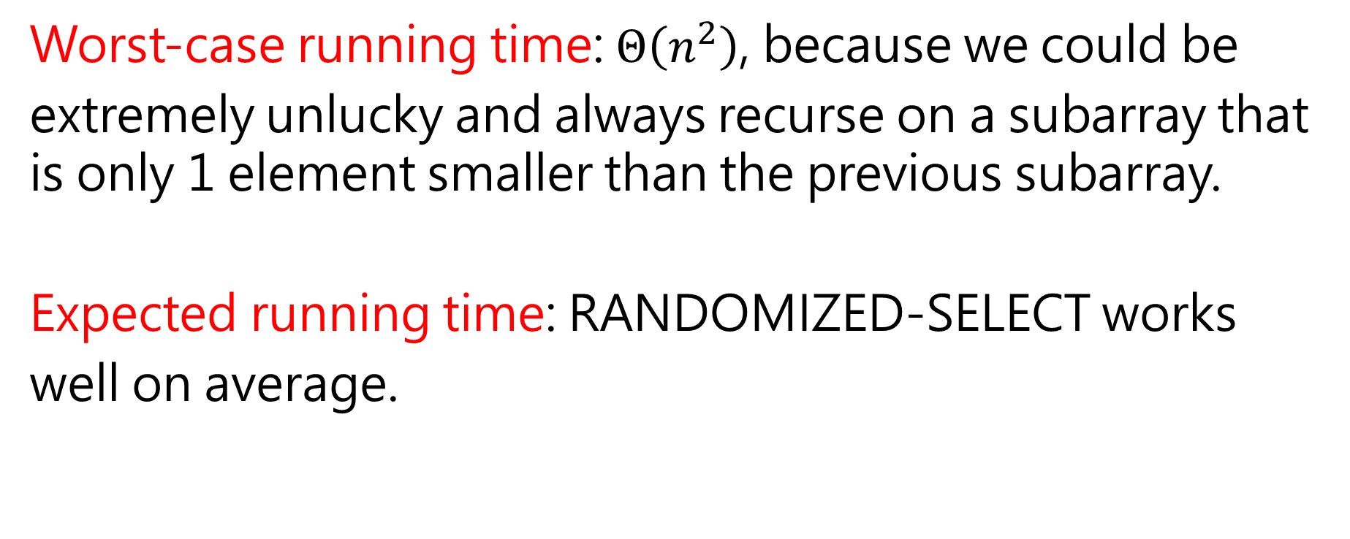
Analysis
Worst-case running time: $Θ\left(n^{2}\right)$, because we could be
extremely unlucky and always recurse on a subarray that is only 1 element smaller than the previous subarray.
Expected running time: RANDOMIZED-SELECT works
well on average.

Slide 19
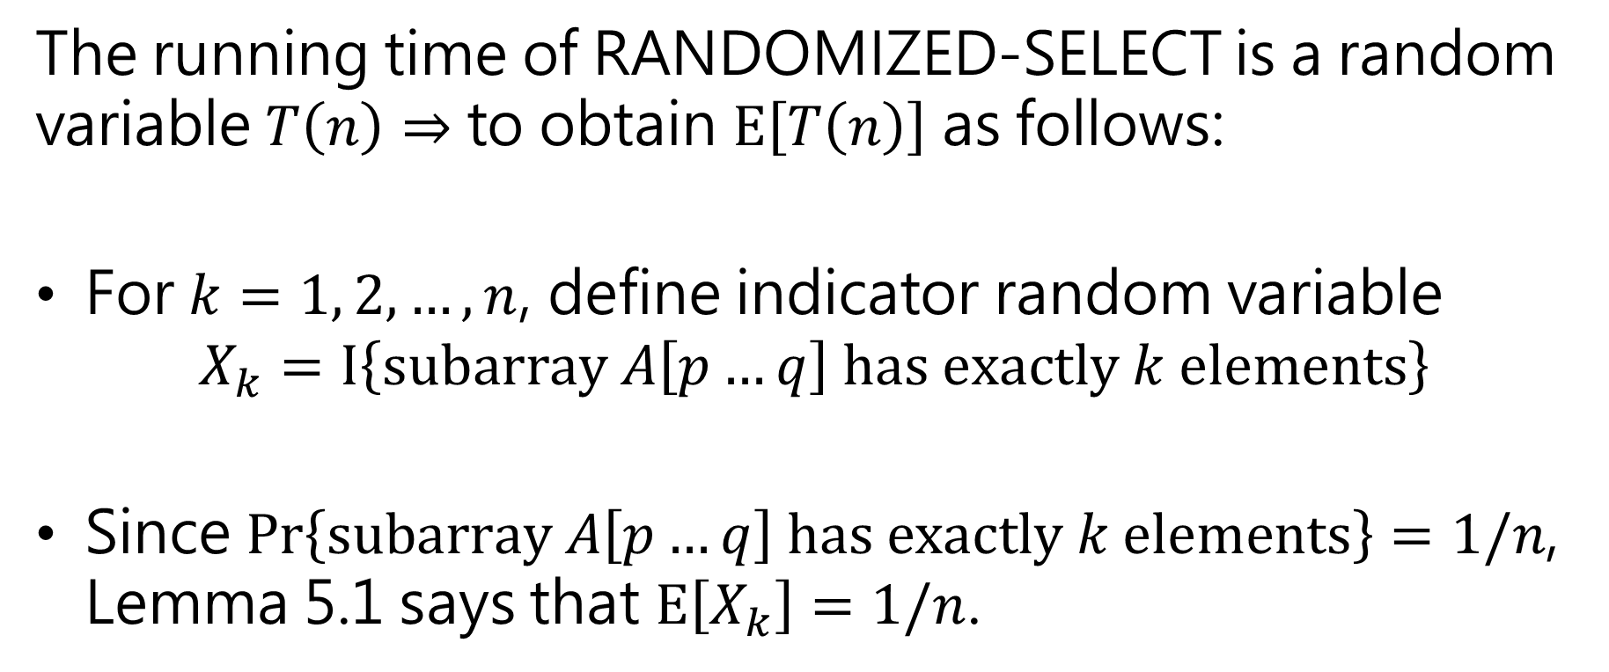
Analysis
The running time of RANDOMIZED-SELECT is a random variable $T\left(n\right)⇒$ to obtain $E\left[T\left(n\right)\right]$ as follows:
For $k=1, 2,…, n$, define indicator random variable $X_{k}=I\left\{subarray A\left[p…q\right] has exactly k elements\right\}$
Since $Pr\left\{subarray A\left[p…q\right] has exactly k elements\right\}=1/n$, Lemma 5.1 says that $E\left[X_{k}\right]=1/n$.

Slide 20
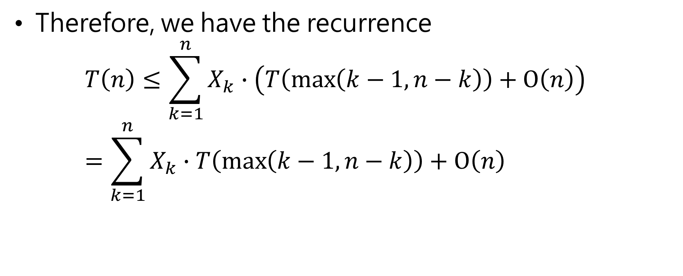
Analysis
Therefore, we have the recurrence $T\left(n\right)≤\sum_{k=1}^{n}{X_{k}∙\left(T\left(\max\left(k−1,n−k\right)\right)+O\left(n\right)\right)}$ $=\sum_{k=1}^{n}{X_{k}∙T\left(\max\left(k−1,n−k\right)\right)+O\left(n\right)}$

Slide 21
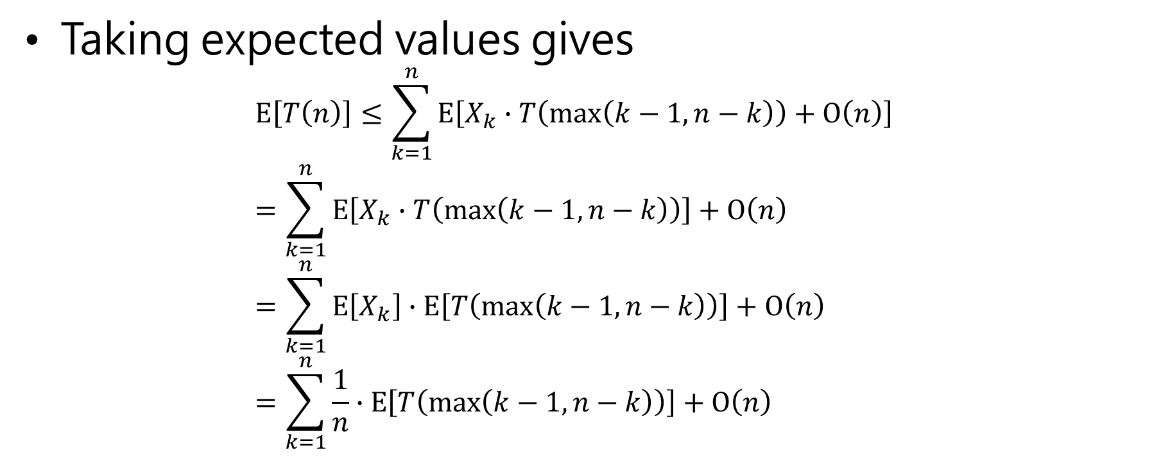
Analysis
Taking expected values gives $E\left[T\left(n\right)\right]≤\sum_{k=1}^{n}{E\left[X_{k}∙T\left(\max\left(k−1,n−k\right)\right)+O\left(n\right)\right]}$ $=\sum_{k=1}^{n}{E\left[X_{k}∙T\left(\max\left(k−1,n−k\right)\right)\right]}+O\left(n\right)$ $=\sum_{k=1}^{n}{E\left[X_{k}\right]∙E\left[T\left(\max\left(k−1,n−k\right)\right)\right]}+O\left(n\right)$ $=\sum_{k=1}^{n}{\frac{1}{n}∙E\left[T\left(\max\left(k−1,n−k\right)\right)\right]}+O\left(n\right)$
(linearity of expectation)
(equation (C.23))

Slide 22
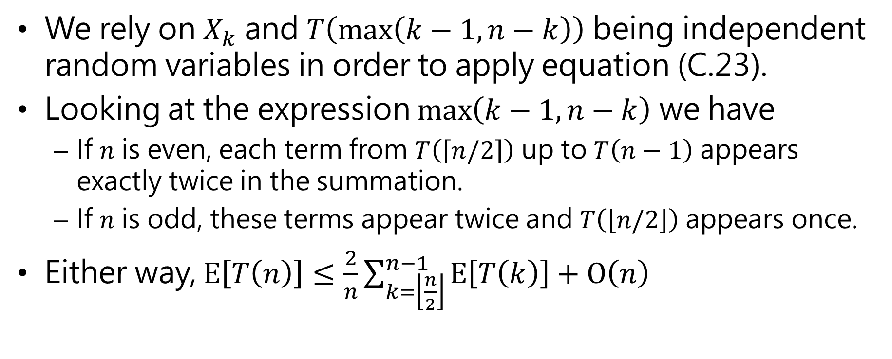
Analysis
We rely on $X_{k}$ and $T\left(\max\left(k−1,n−k\right)\right)$ being independent random variables in order to apply equation (C.23).
Looking at the expression $\max\left(k−1,n−k\right)$ we have
If $n$ is even, each term from $T\left(\left\lceil n/2\right\rceil \right)$ up to $T\left(n−1\right)$ appears exactly twice in the summation.
If $n$ is odd, these terms appear twice and $T\left(\left\lfloor n/2\right\rfloor \right)$appears once.
Either way, $E\left[T\left(n\right)\right]≤\frac{2}{n}\sum_{k=\left\lfloor \frac{n}{2}\right\rfloor }^{n−1}{E\left[T\left(k\right)\right]}+O\left(n\right)$

Slide 23
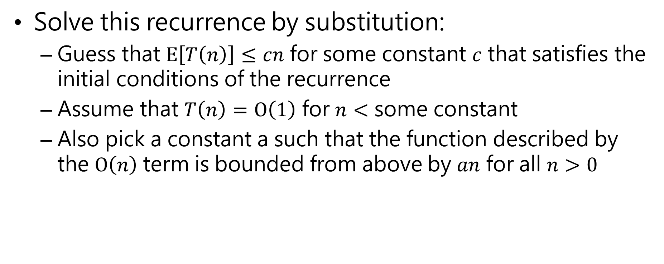
Analysis
Solve this recurrence by substitution:
Guess that $E\left[T\left(n\right)\right]≤cn$ for some constant $c$ that satisfies the initial conditions of the recurrence
Assume that $T\left(n\right)=O\left(1\right)$ for $n<$ some constant
Also pick a constant a such that the function described by the $O\left(n\right)$ term is bounded from above by $an$ for all $n>0$

Slide 24
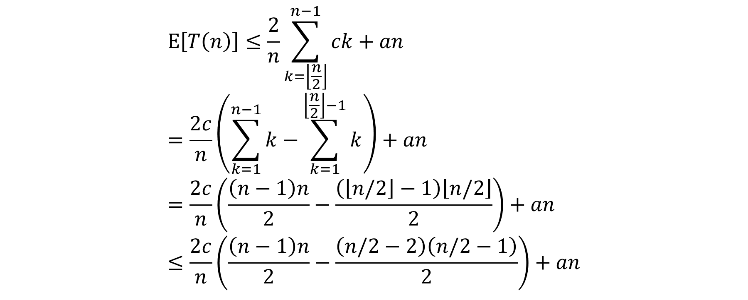
Analysis
$$E\left[T\left(n\right)\right]≤\frac{2}{n}\sum_{k=\left\lfloor \frac{n}{2}\right\rfloor }^{n−1}{ck}+an \\ =\frac{2c}{n}\left(\sum_{k=1}^{n−1}{k}−\sum_{k=1}^{\left\lfloor \frac{n}{2}\right\rfloor −1}{k}\right)+an \\ =\frac{2c}{n}\left(\frac{\left(n−1\right)n}{2}−\frac{\left(\left\lfloor n/2\right\rfloor −1\right)\left\lfloor n/2\right\rfloor }{2}\right)+an \\ ≤\frac{2c}{n}\left(\frac{\left(n−1\right)n}{2}−\frac{\left(n/2−2\right)\left(n/2−1\right)}{2}\right)+an$$

Slide 25

Analysis
$$=\frac{2c}{n}\left(\frac{n^{2}−n}{2}−\frac{n^{2}/4−3n/4+2}{2}\right)+an \\ =\frac{c}{n}\left(\frac{{3n}^{2}}{4}+\frac{n}{2}−2\right)+an \\ =c\left(\frac{3n}{4}+\frac{1}{2}−\frac{2}{n}\right)+an \\ ≤\frac{3cn}{4}+\frac{c}{2}+an \\ =cn−\left(\frac{cn}{4}−\frac{c}{2}−an\right)$$

Slide 26
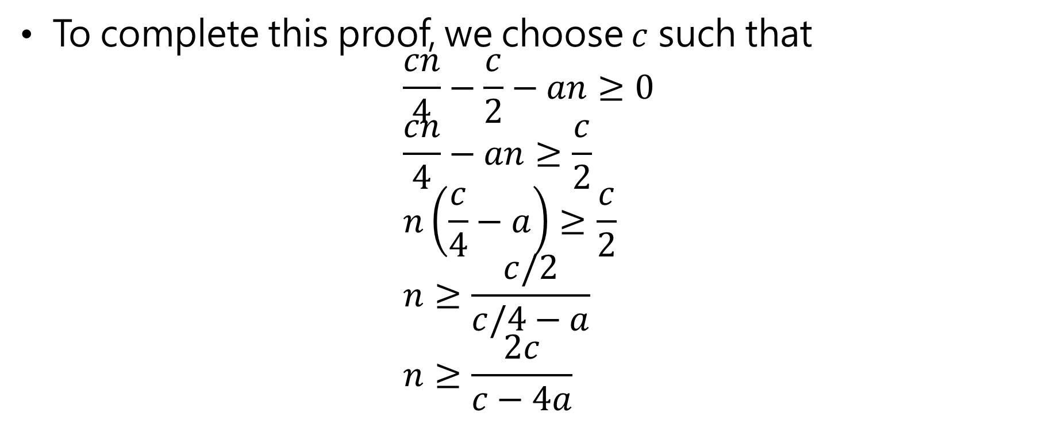
Analysis
To complete this proof, we choose $c$ such that $\frac{cn}{4}−\frac{c}{2}−an≥0$ $\frac{cn}{4}−an≥\frac{c}{2}$ $n\left(\frac{c}{4}−a\right)≥\frac{c}{2}$ $n≥\frac{c/2}{c/4−a}$ $n≥\frac{2c}{c−4a}$

Slide 27
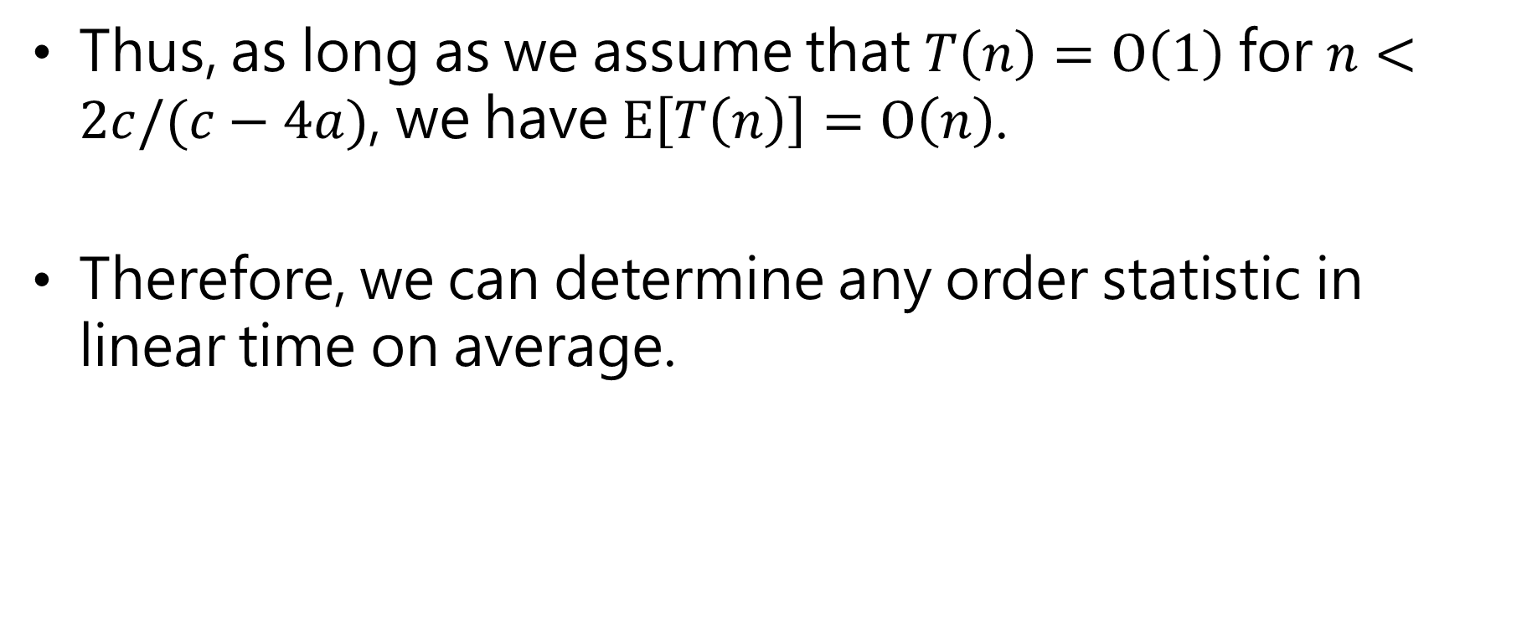
Analysis
Thus, as long as we assume that $T\left(n\right)=O\left(1\right)$ for $n<2c/(c−4a)$, we have $E\left[T\left(n\right)\right]=O\left(n\right)$.
Therefore, we can determine any order statistic in linear time on average.

Slide 28
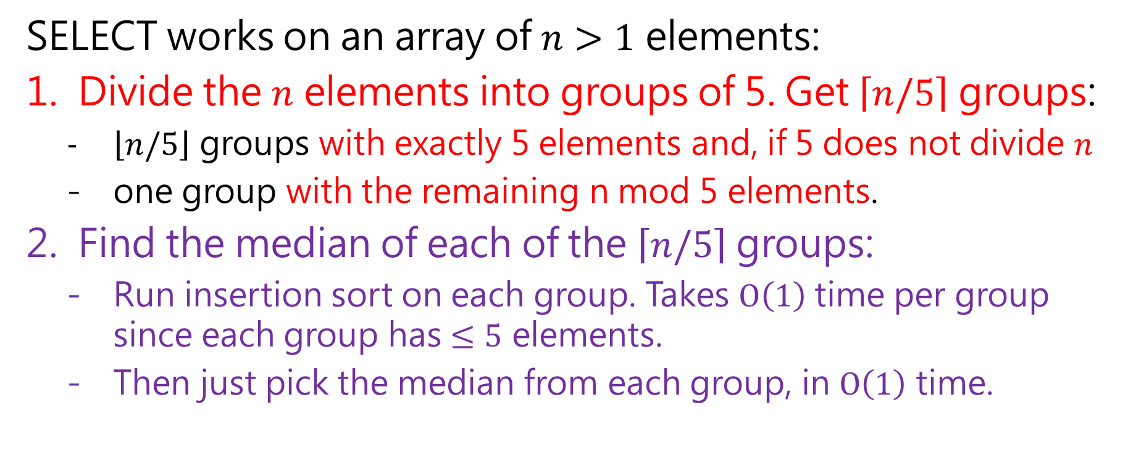
Selection in worst-case linear time
SELECT works on an array of $n>1$ elements:
Divide the $n$ elements into groups of 5. Get $\left\lceil n/5\right\rceil$ groups:
$\left\lfloor n/5\right\rfloor$ groups with exactly 5 elements and, if 5 does not divide $n$
one group with the remaining n mod 5 elements.
Find the median of each of the $\left\lceil n/5\right\rceil$ groups:
Run insertion sort on each group. Takes $O\left(1\right)$ time per group since each group has $≤5$ elements.
Then just pick the median from each group, in $O\left(1\right)$ time.

Slide 29
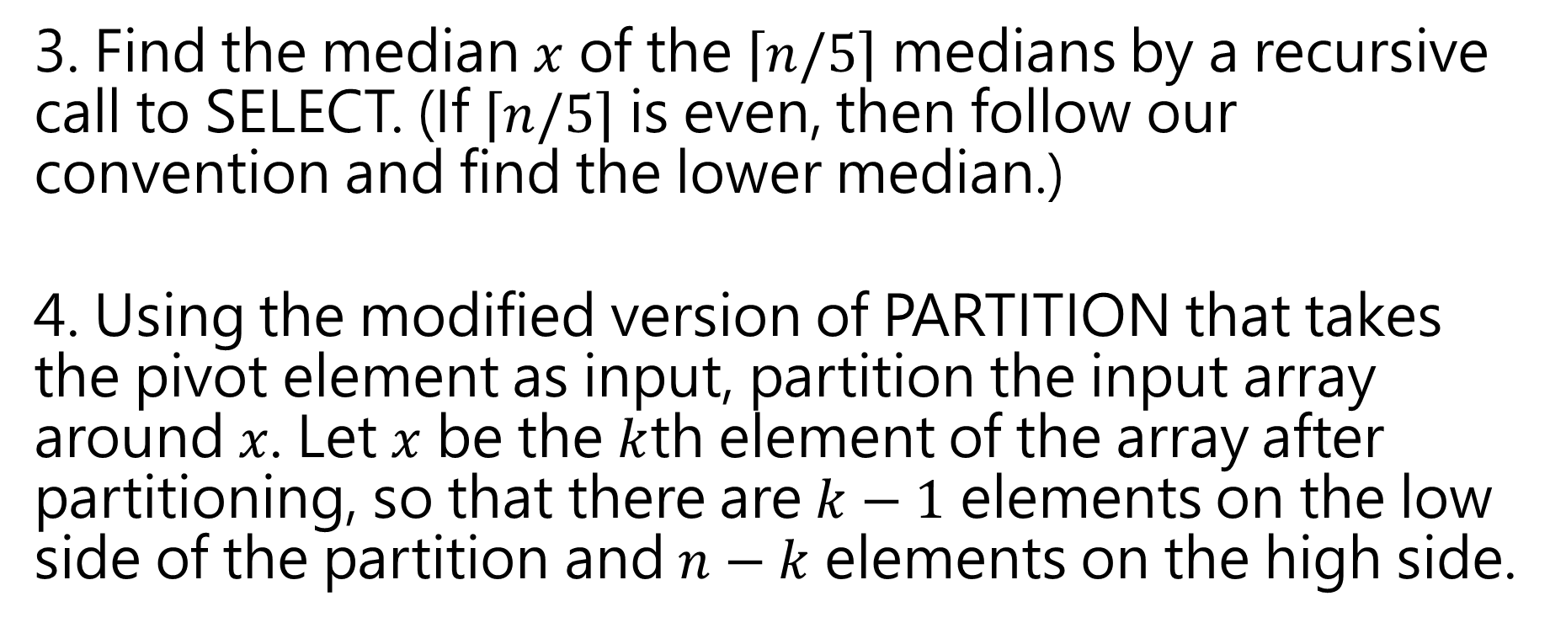
Selection in worst-case linear time
3. Find the median $x$ of the $\left\lceil n/5\right\rceil$ medians by a recursive call to SELECT. (If $\left\lceil n/5\right\rceil$ is even, then follow our convention and find the lower median.)
4. Using the modified version of PARTITION that takes the pivot element as input, partition the input array around $x$. Let $x$ be the $k$th element of the array after partitioning, so that there are $k−1$ elements on the low side of the partition and $n−k$ elements on the high side.

Slide 30
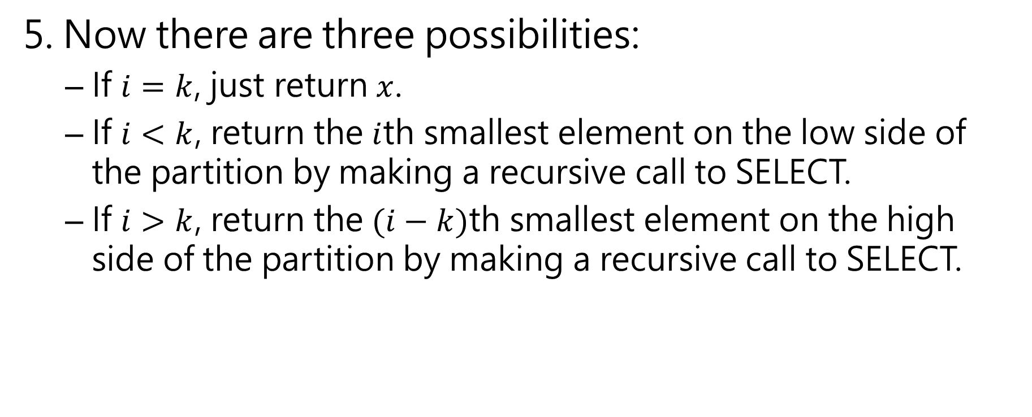
Selection in worst-case linear time
5. Now there are three possibilities:
If $i=k$, just return $x$.
If $i<k$, return the $i$th smallest element on the low side of the partition by making a recursive call to SELECT.
If $i>k$, return the $(i−k)$th smallest element on the high side of the partition by making a recursive call to SELECT.

Slide 31
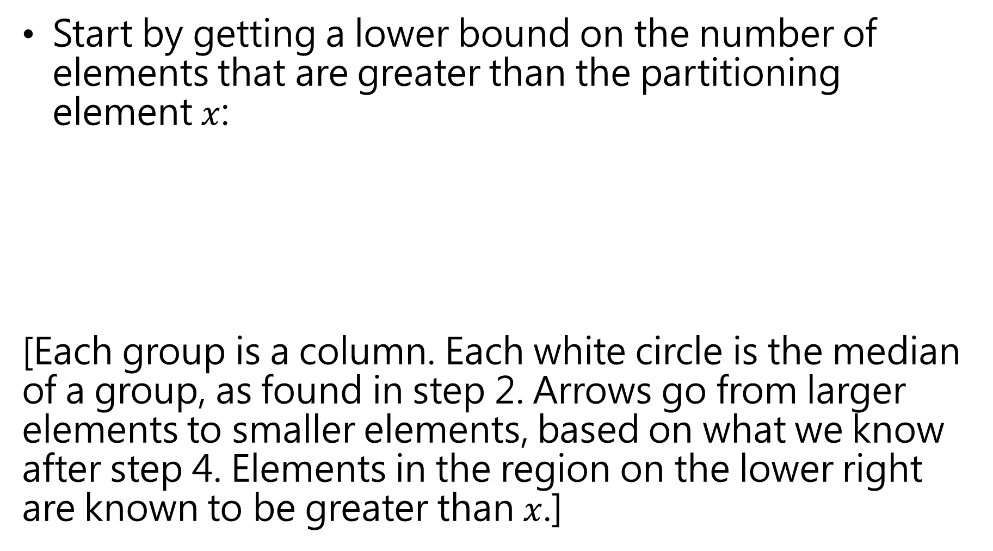
Start by getting a lower bound on the number of elements that are greater than the partitioning element $x$:
[Each group is a column. Each white circle is the median of a group, as found in step 2. Arrows go from larger elements to smaller elements, based on what we know after step 4. Elements in the region on the lower right are known to be greater than $x$.]

Slide 32
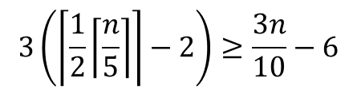
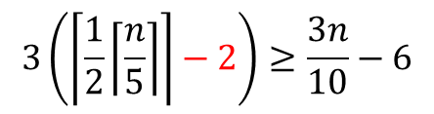
$$3\left(\left\lceil \frac{1}{2}\left\lceil \frac{n}{5}\right\rceil \right\rceil −2\right)≥\frac{3n}{10}−6$$
$$3\left(\left\lceil \frac{1}{2}\left\lceil \frac{n}{5}\right\rceil \right\rceil −2\right)≥\frac{3n}{10}−6$$

Slide 33
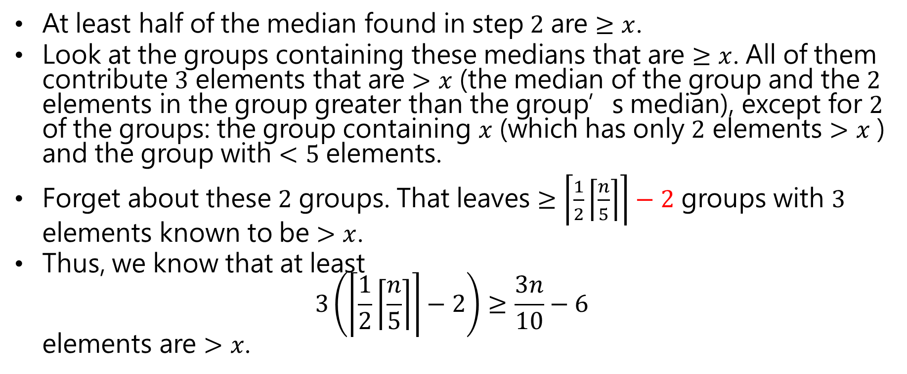
Analysis
At least half of the median found in step $2$ are $≥x$.
Look at the groups containing these medians that are $≥x$. All of them contribute $3$ elements that are $>x$ (the median of the group and the $2$ elements in the group greater than the group’s median), except for $2$ of the groups: the group containing $x$ (which has only $2$ elements $>x$ ) and the group with $<5$ elements.
Forget about these $2$ groups. That leaves $≥\left\lceil \frac{1}{2}\left\lceil \frac{n}{5}\right\rceil \right\rceil −2$ groups with $3$ elements known to be $>x$.
Thus, we know that at least $3\left(\left\lceil \frac{1}{2}\left\lceil \frac{n}{5}\right\rceil \right\rceil −2\right)≥\frac{3n}{10}−6$ elements are $>x$.

Slide 34
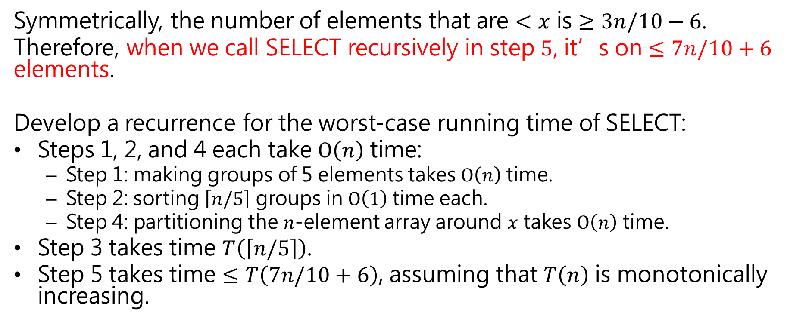
Analysis
Symmetrically, the number of elements that are $<x$ is $≥3n/10−6$.
Therefore, when we call SELECT recursively in step $5$, it’s on $≤7n/10+6$ elements.
Develop a recurrence for the worst-case running time of SELECT:
Steps 1, 2, and 4 each take $O\left(n\right)$ time:
Step 1: making groups of 5 elements takes $O\left(n\right)$time.
Step 2: sorting $\left\lceil n/5\right\rceil$ groups in $O\left(1\right)$time each.
Step 4: partitioning the $n$-element array around $x$ takes $O\left(n\right)$ time.
Step 3 takes time $T\left(\left\lceil n/5\right\rceil \right)$.
Step 5 takes time $≤T\left(7n/10+6\right)$, assuming that $T\left(n\right)$ is monotonically increasing.

Slide 35
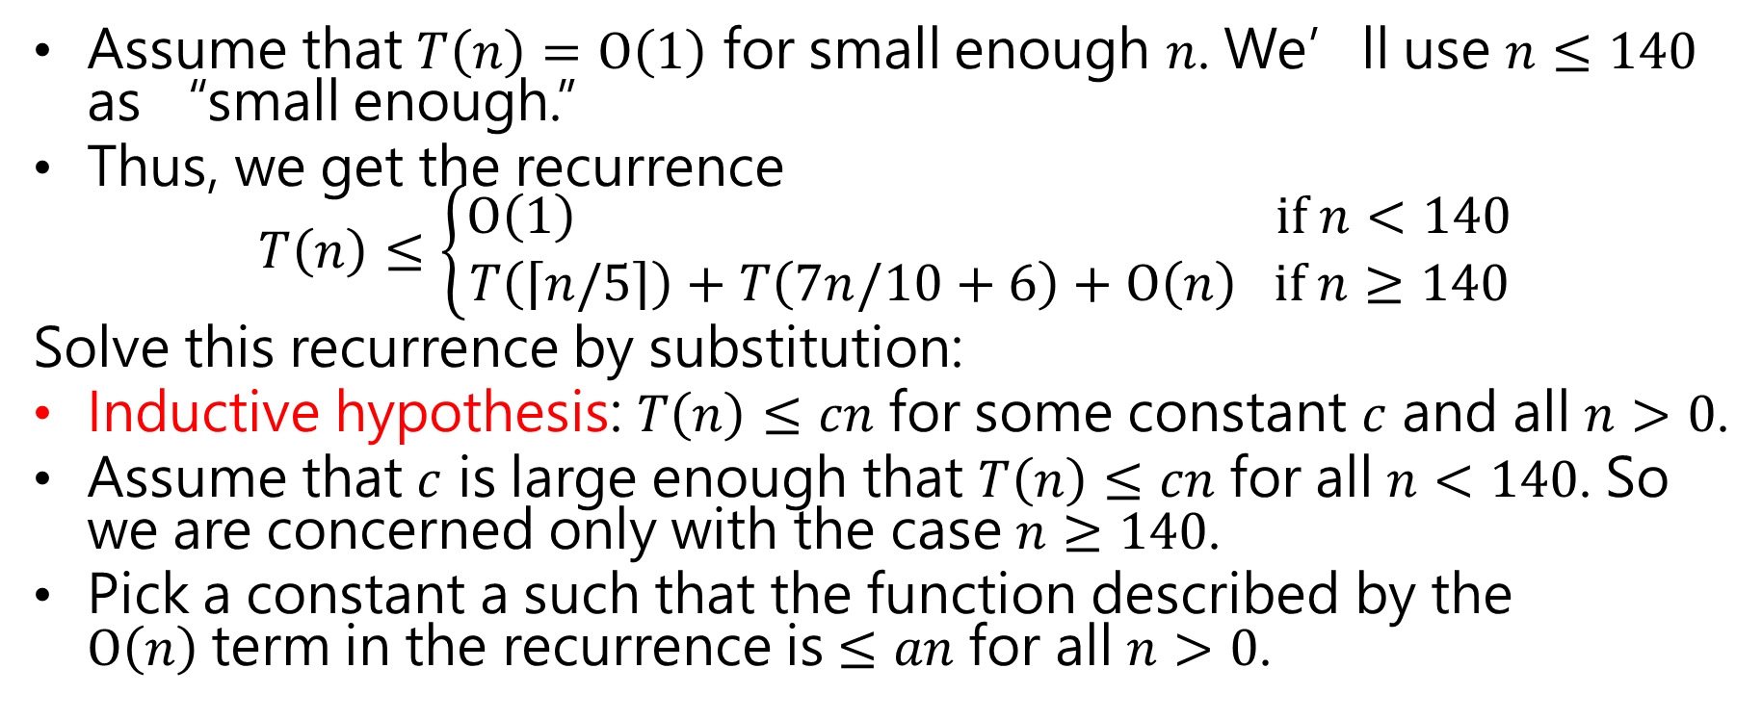
Analysis
Assume that $T\left(n\right)=O\left(1\right)$ for small enough $n$. We’ll use $n≤140$ as “small enough.”
Thus, we get the recurrence $T\left(n\right)≤\left\{\begin{aligned}O\left(1\right) if n<140 \\ T\left(\left\lceil n/5\right\rceil \right)+T\left(7n/10+6\right)+O\left(n\right) if n≥140\end{aligned}\right.$
Solve this recurrence by substitution:
Inductive hypothesis: $T\left(n\right)≤cn$ for some constant $c$ and all $n>0$.
Assume that $c$ is large enough that $T\left(n\right)≤cn$ for all $n<140$. So we are concerned only with the case $n≥140$.
Pick a constant a such that the function described by the $O\left(n\right)$term in the recurrence is $≤an$ for all $n>0$.

Slide 36
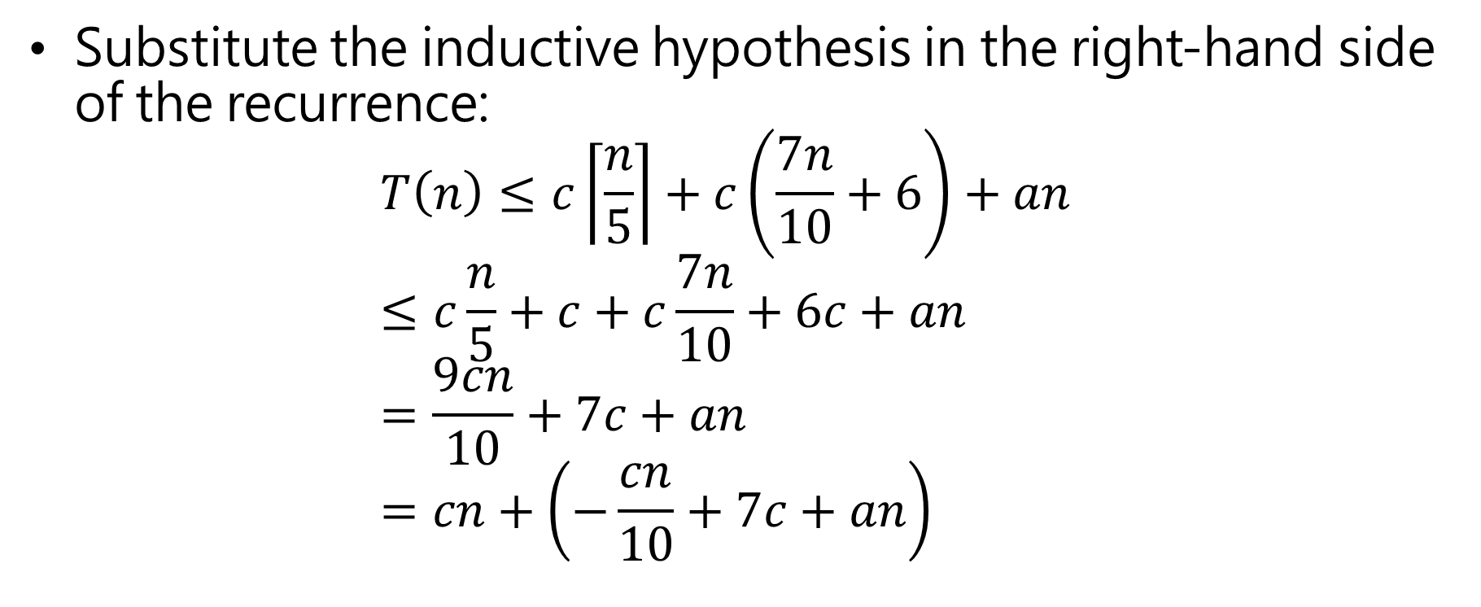
Analysis
Substitute the inductive hypothesis in the right-hand side of the recurrence: $T\left(n\right)≤c\left\lceil \frac{n}{5}\right\rceil +c\left(\frac{7n}{10}+6\right)+an$ $≤c\frac{n}{5}+c+c\frac{7n}{10}+6c+an$ $=\frac{9cn}{10}+7c+an$ $=cn+\left(−\frac{cn}{10}+7c+an\right)$

Slide 37
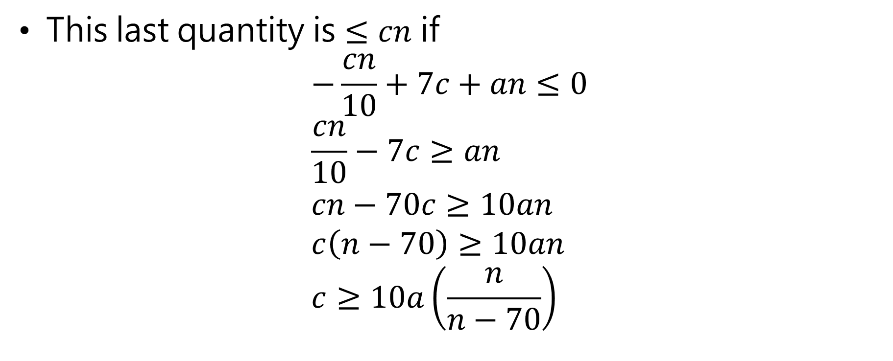
Analysis
This last quantity is $≤cn$ if $−\frac{cn}{10}+7c+an≤0$ $\frac{cn}{10}−7c≥an$ $cn−70c≥10an$ $c\left(n−70\right)≥10an$ $c≥10a\left(\frac{n}{n−70}\right)$

Slide 38
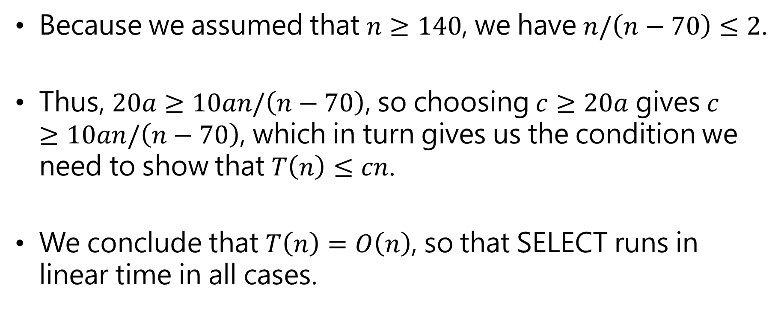
Analysis
Because we assumed that $n≥140$, we have $n/\left(n−70\right)≤2$.
Thus, $20a≥10an/\left(n−70\right)$, so choosing $c≥20a$ gives $c≥10an/\left(n−70\right)$, which in turn gives us the condition we need to show that $T\left(n\right)≤cn$.
We conclude that $T\left(n\right)=O\left(n\right)$, so that SELECT runs in linear time in all cases.

Slide 39
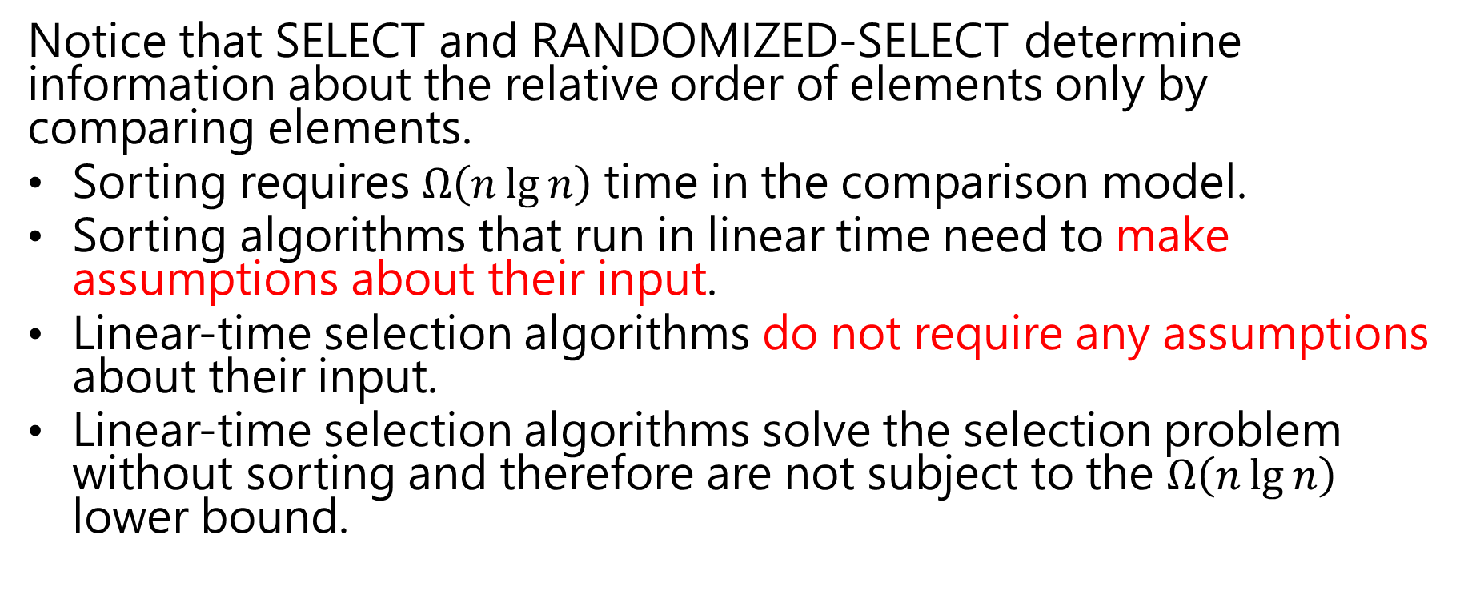
Analysis
Notice that SELECT and RANDOMIZED-SELECT determine information about the relative order of elements only by comparing elements.
Sorting requires $Ω\left(n\lg{n}\right)$ time in the comparison model.
Sorting algorithms that run in linear time need to make assumptions about their input.
Linear-time selection algorithms do not require any assumptions about their input.
Linear-time selection algorithms solve the selection problem without sorting and therefore are not subject to the $Ω\left(n\lg{n}\right)$ lower bound.

Slide 40
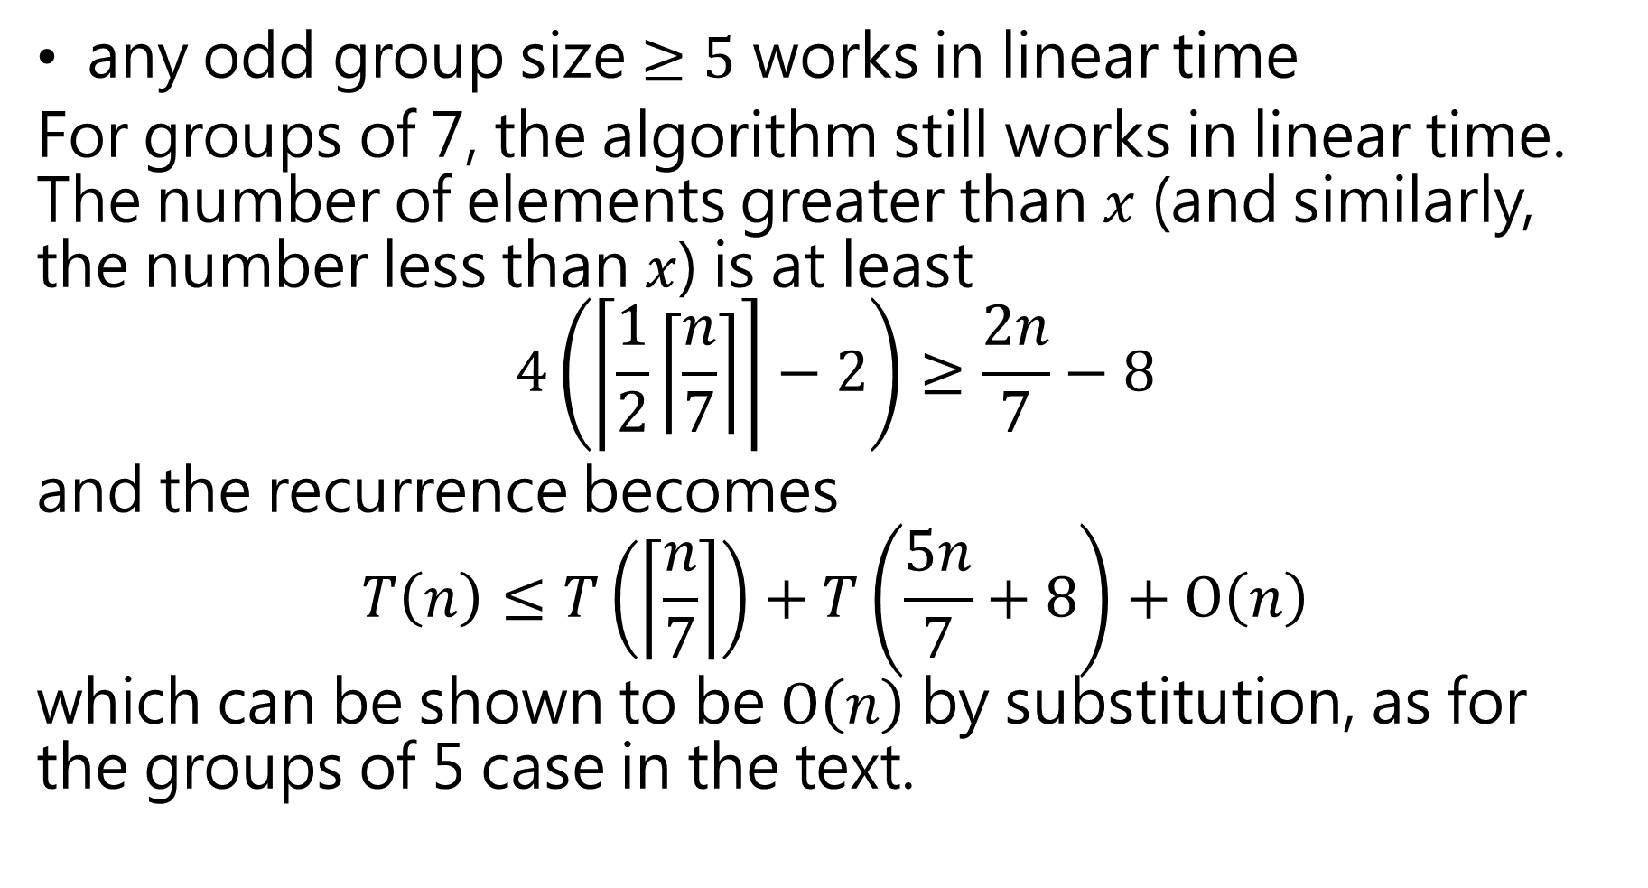
any odd group size $≥5$ works in linear time
For groups of 7, the algorithm still works in linear time. The number of elements greater than $x$ (and similarly, the number less than $x$) is at least $$4\left(\left\lceil \frac{1}{2}\left\lceil \frac{n}{7}\right\rceil \right\rceil −2\right)≥\frac{2n}{7}−8$$
and the recurrence becomes $$T\left(n\right)≤T\left(\left\lceil \frac{n}{7}\right\rceil \right)+T\left(\frac{5n}{7}+8\right)+O\left(n\right)$$ which can be shown to be $O\left(n\right)$ by substitution, as for the groups of 5 case in the text.

Slide 41
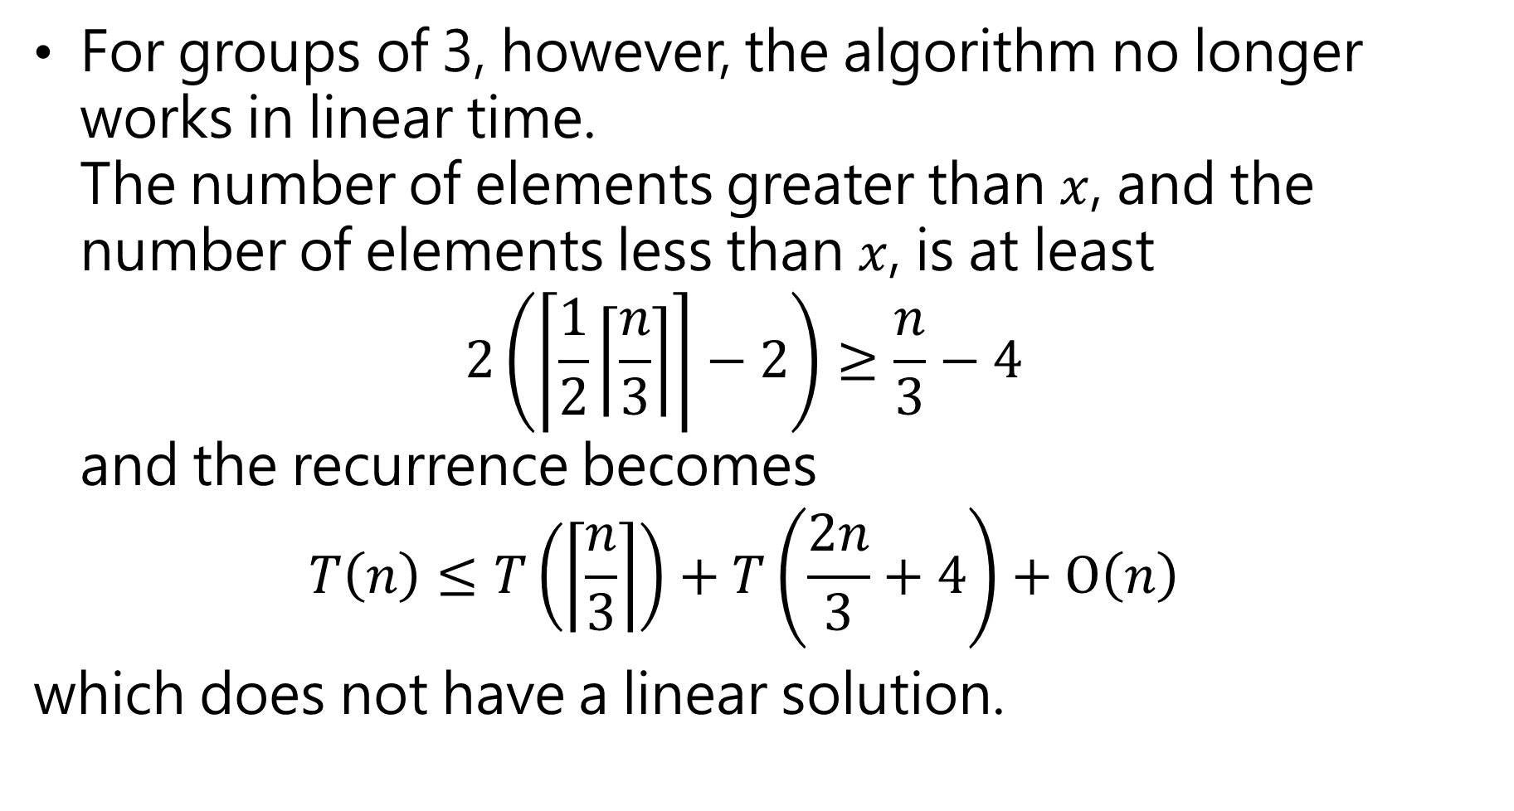
For groups of 3, however, the algorithm no longer works in linear time. The number of elements greater than $x$, and the number of elements less than $x$, is at least $2\left(\left\lceil \frac{1}{2}\left\lceil \frac{n}{3}\right\rceil \right\rceil −2\right)≥\frac{n}{3}−4$ and the recurrence becomes $T\left(n\right)≤T\left(\left\lceil \frac{n}{3}\right\rceil \right)+T\left(\frac{2n}{3}+4\right)+O\left(n\right)$
which does not have a linear solution.

Slide 42
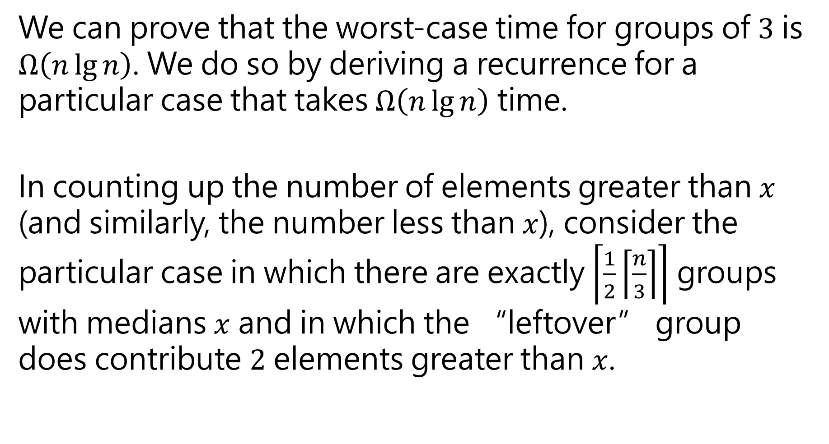
We can prove that the worst-case time for groups of $3$ is $Ω\left(n\lg{n}\right)$. We do so by deriving a recurrence for a particular case that takes $Ω\left(n\lg{n}\right)$ time.
In counting up the number of elements greater than $x$ (and similarly, the number less than $x$), consider the particular case in which there are exactly $\left\lceil \frac{1}{2}\left\lceil \frac{n}{3}\right\rceil \right\rceil$ groups with medians $x$ and in which the “leftover” group does contribute $2$ elements greater than $x$.

Slide 43
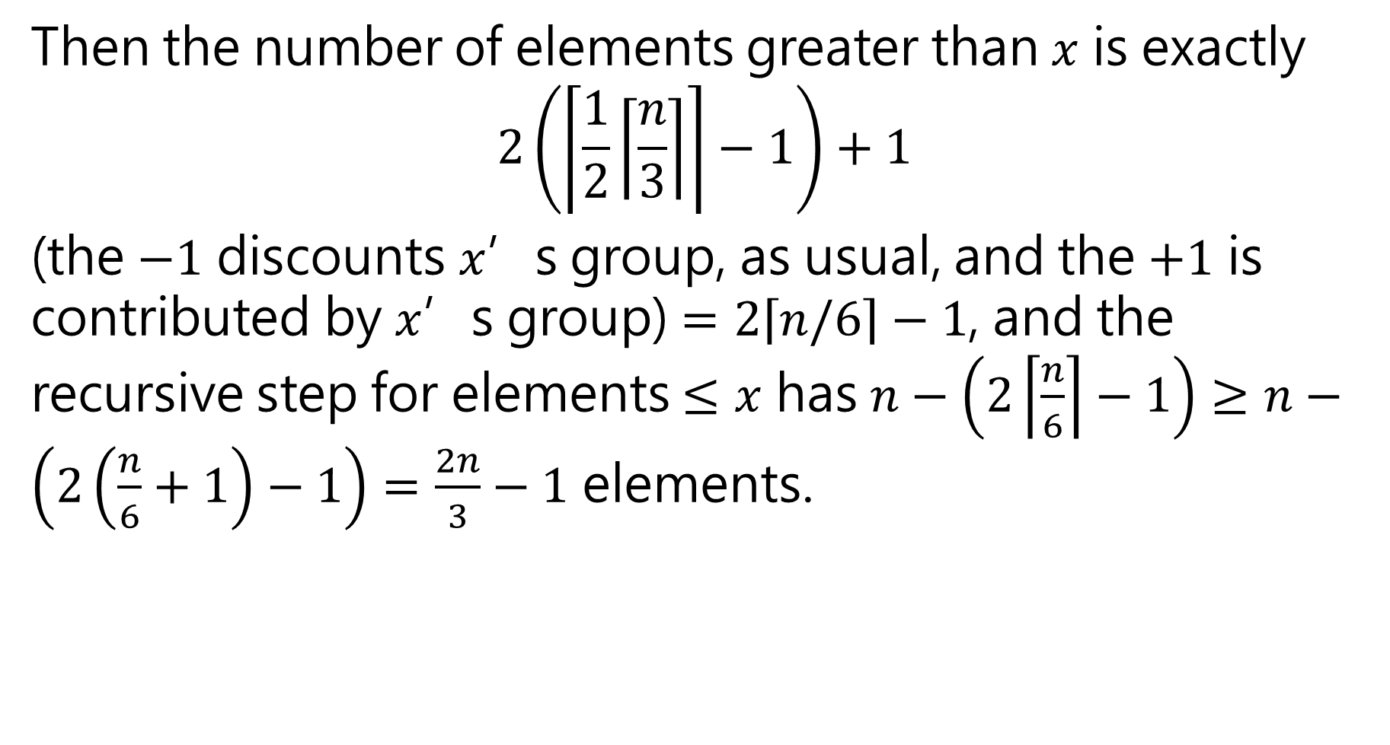
Then the number of elements greater than $x$ is exactly $$2\left(\left\lceil \frac{1}{2}\left\lceil \frac{n}{3}\right\rceil \right\rceil −1\right)+1$$
(the $−1$ discounts $x$’s group, as usual, and the $+1$ is contributed by $x$’s group) $=2\left\lceil n/6\right\rceil −1$, and the recursive step for elements $≤x$ has $n−\left(2\left\lceil \frac{n}{6}\right\rceil −1\right)≥n−\left(2\left(\frac{n}{6}+1\right)−1\right)=\frac{2n}{3}−1$ elements.

Slide 44
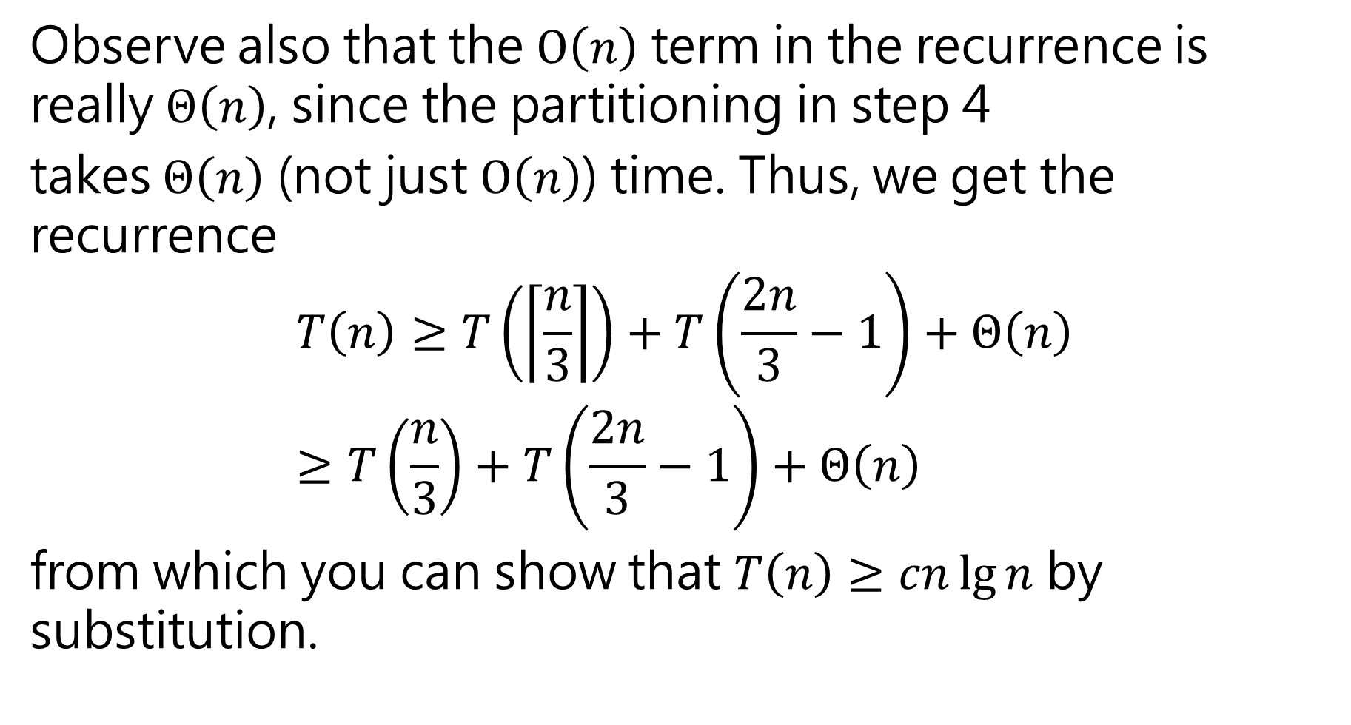
Observe also that the $O\left(n\right)$ term in the recurrence is really $Θ\left(n\right)$, since the partitioning in step 4
takes $Θ\left(n\right)$ (not just $O\left(n\right)$) time. Thus, we get the recurrence
$$T\left(n\right)≥T\left(\left\lceil \frac{n}{3}\right\rceil \right)+T\left(\frac{2n}{3}−1\right)+Θ\left(n\right)≥T\left(\frac{n}{3}\right)+T\left(\frac{2n}{3}−1\right)+Θ\left(n\right)$$
from which you can show that $T\left(n\right)≥cn\lg{n}$ by substitution.

